Slide 1
Lexiconcraft: An innovative language symbol generator
VIJAY RAGHAVAN.V (192210704)
JAZIM.J (192210471)
ROHIT RAGHAVENDRA.M (192211415)

Slide 2
introduction
CODECOMPOSER is a Graphical User Interface (GUI) tool designed to
facilitate the generation of Three Address Code (TAC) in programming
languages. TAC is an intermediate representation used in compilers and
interpreters to simplify complex source code into a format that is easier to
analyze and optimize. The primary objective of CODECOMPOSER is to
provide a user-friendly environment for generating and visualizing TAC. The
GUI allows programmers to input source code in various programming
languages such as C, Java, or Python, and then automatically generates the
corresponding TAC.

Slide 3
Methodology
1. The evaluation process will involve using CODECOMPOSER to generate TAC from sample source code in various languages and analyzing the generated TAC for accuracy and optimization opportunities. 2. Usability testing sessions will be conducted with participants to assess the GUI design, navigation flow, and overall user experience of CODECOMPOSER. 3. A comparative analysis will be performed to benchmark CODECOMPOSER against other existing code generation and analysis tools, evaluating features, performance, and user satisfaction.

Slide 4
Future Prospects And Potential
With advancements in machine learning and artificial intelligence, the tool could learn from user preferences, generating symbols that increasingly align with individual or cultural aesthetics.
As technology evolves, Lexiconcraft could be integrated into broader creative platforms, allowing users to seamlessly apply symbols across different media (e.g., digital art, 3D modeling, web design).
Furthermore, Lexiconcraft could be expanded beyond its original scope. For instance, it might integrate with virtual reality (VR) environments, where users can interact with symbols in three-dimensional space.

Slide 5
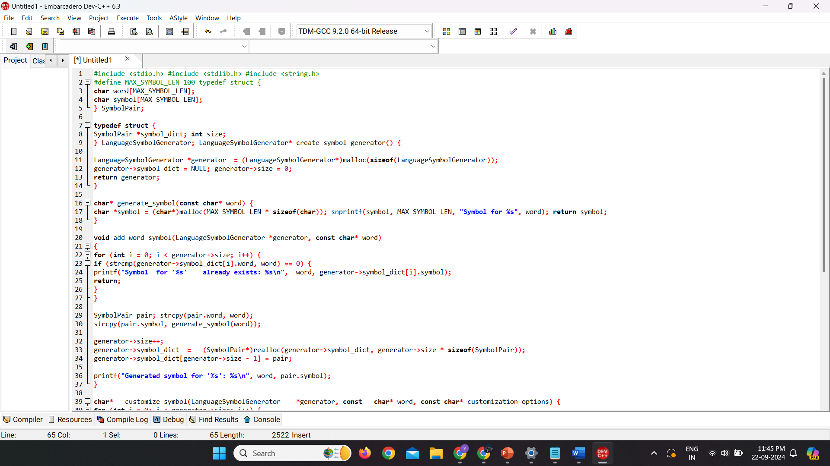
Program

Slide 6
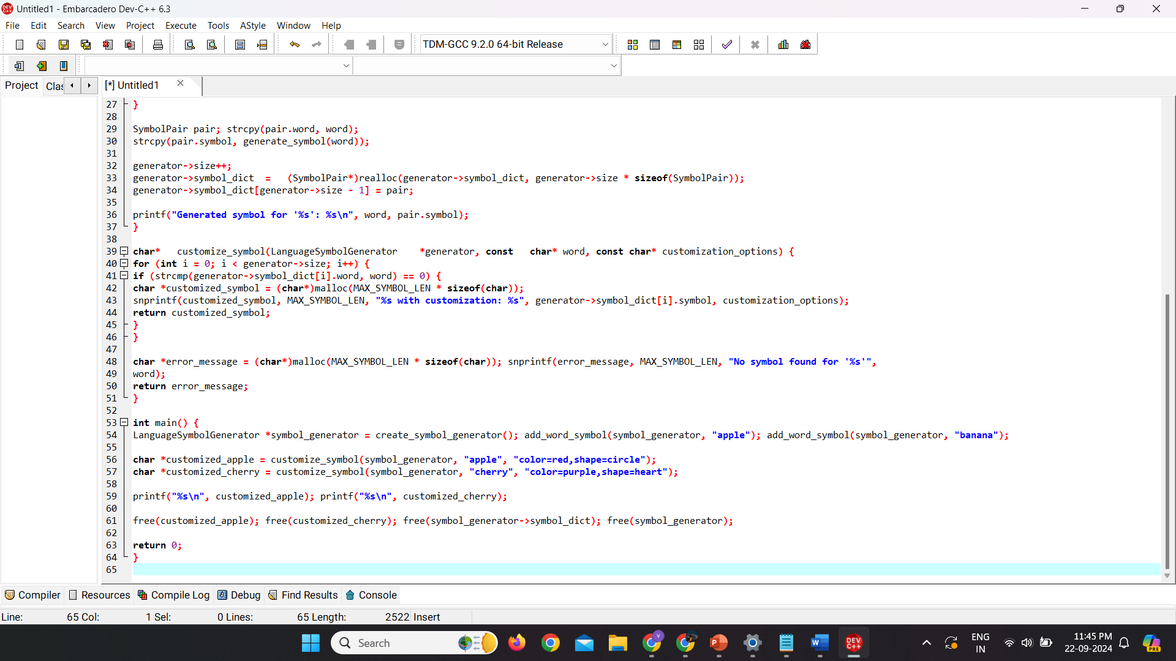
Program

Slide 7
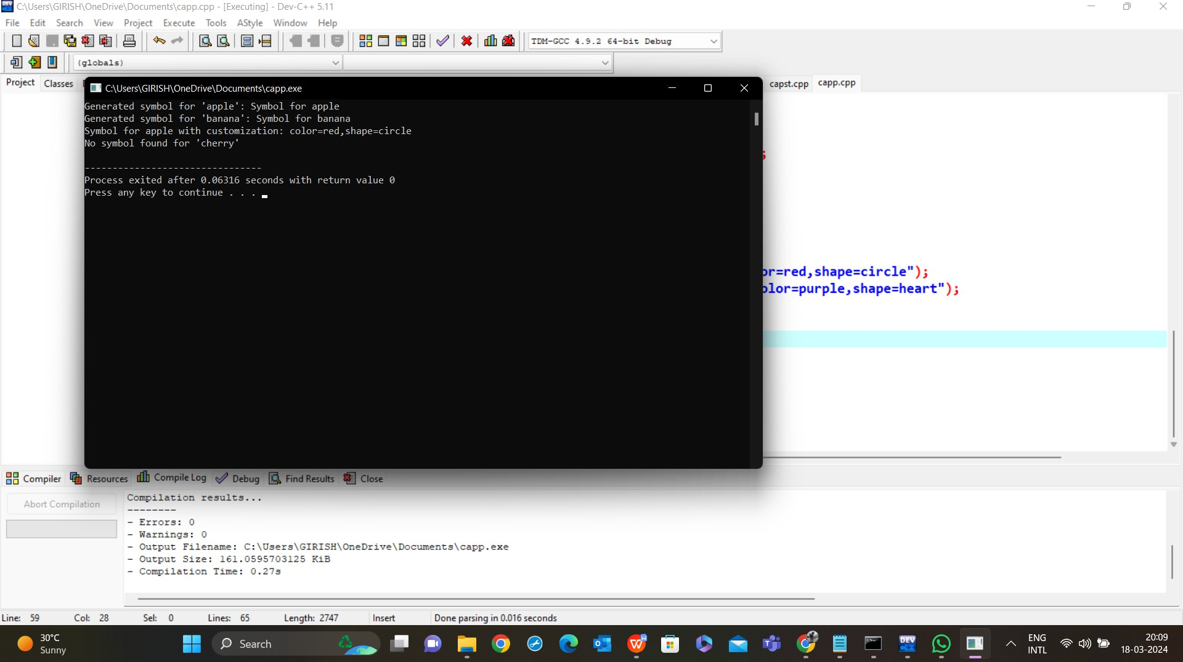
Output

Slide 8
Result
LexiconCraft aims to deliver a robust and user-friendly tool that empowers users to generate, customize, and integrate language symbols for a wide array of applications.
It would utilize advanced algorithms, machine learning techniques, and a user-friendly interface to achieve its goals effectively
CODECOMPOSER is a cutting-edge Graphical User Interface (GUI) designed to streamline the process of TAC generation and analysis..

Slide 9
Conclusion
CODECOMPOSER demonstrates a high degree of accuracy in generating TAC from source code across multiple programming languages. Its parsing algorithms and optimization suggestions contribute to efficient code representation and potential performance enhancements
In conclusion, the evaluation of CODECOMPOSER in Three Address Code (TAC) generation and analysis has provided valuable insights into its effectiveness, usability, and potential areas for improvement. .

Slide 10
Thank you

